Slide 1

SE 231 · PROJECT PROPOSAL PRESENTATION
Smart Home Automation and Energy Optimization System
AI-integrated home automation, water management and energy monitoring
Md. Al Ruman · S. M. Rafid Islam
Section 44_D2 · Group 07 · System Analysis & Design Capstone Project
Course Teacher: Md. Selim Reza, Assistant Professor
Notes:
Al Ruman: Greet the teacher, introduce the project title, the course and the two team members.

Slide 2
Our Team
AR
RI
Md. Al Ruman
S. M. Rafid Islam
ID: 251-35-583
ID: 251-35-171
Section 44_D2 · Group 07
Section 44_D2 · Group 07
Backend & AI Development
Hardware & MQTT Integration
Notes:
Al Ruman: Introduce both members with their IDs and primary areas of responsibility.

Slide 3



Introduction
Manual household control
Lights, fans, air conditioners and water pumps still depend on users switching them on and off.
What the system does
Senses occupancy, light, temperature and water level
Controls lights, fans, AC and the water pump
Monitors electricity usage live and over time
Keeps manual override always available
Unmonitored energy use
Appliances stay active when not needed, and electricity consumption is rarely tracked.
Our approach
Sensors, automation rules and an AI component that predicts usage and suggests savings.
Notes:
Al Ruman: Many household tasks are still manual and electricity use is not monitored. Our system uses sensors and AI to automate and optimise.

Slide 4


Problem Statement
Manual control
No energy visibility
Local conditions
Lights, fans and ACs are switched by hand, and rooftop tanks are checked manually before running the pump.
Households have no simple way to see which devices use more electricity or to spot unusual usage.
Prepaid meters and load-shedding in Bangladesh make household energy management harder.
The gap: existing smart home products mostly offer app-based remote control, and some need costly hardware or complex setup. A practical system should combine automatic control, energy monitoring and AI analysis while keeping manual control.
Notes:
Al Ruman: Explain the three problems and the gap in existing solutions.

Slide 5






How the System Works
1
2
3
4
5
Sense
Analyze
Decide
Automate
Monitor
PIR, LDR, temperature, water level and current sensors collect data through the ESP32.
The backend processes readings; AI analyses energy history.
Automation rules and AI results choose the right action.
Relays switch lights, fans, AC and the water pump.
The dashboard shows live data, alerts and suggestions.
The loop runs continuously. Users can override any connected device manually from the dashboard.
Notes:
Al Ruman: Walk through the five steps: Sense, Analyze, Decide, Automate, Monitor. Mention that manual override is always available.

Slide 6
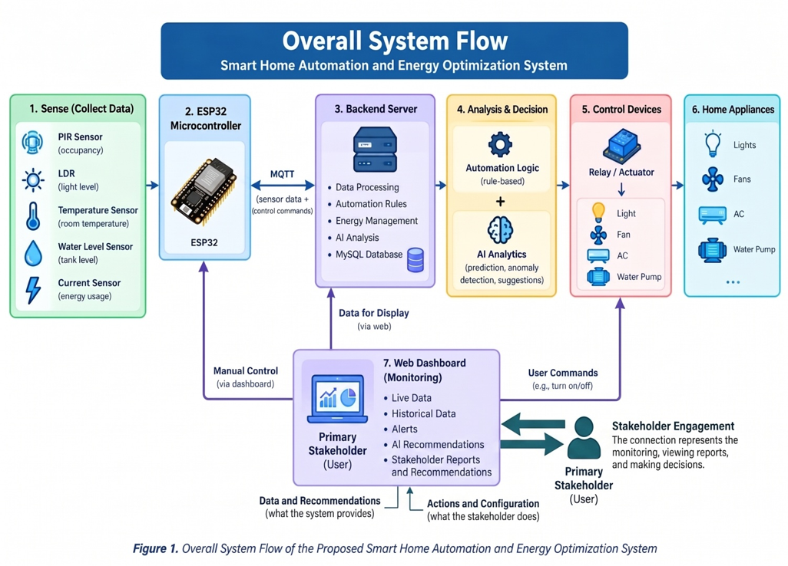
Notes:
Al Ruman: Follow the flow from the sensors, through the ESP32 and MQTT, to the backend, analysis, relays and appliances. The web dashboard lets the user monitor and send manual commands.

Slide 7


Core Modules: Automation
Smart Appliance & Occupancy Control
Water Tank & Pump Automation
Controls lights, fans and AC from occupancy, daylight and temperature.
Monitors the rooftop tank and controls the water pump automatically.
PIR sensor detects people in the room
LDR measures natural light
Temperature sensor drives fan and AC
Relay modules switch the appliances
Ultrasonic sensor reads the water level
Pump runs according to tank level
Basic overflow protection
Basic dry-run protection
Notes:
Rafid: Explain the two automation modules and which sensors each one uses.

Slide 8
Core Modules: Energy & AI
Energy Monitoring
AI Analytics
Collects electricity usage data and shows it on the web dashboard.
Analyses historical energy data using Python and scikit-learn.
CT sensor (e.g., SCT-013) measures current
Live readings
Historical charts
Alerts and manual device controls
Predicts future consumption
Detects unusual usage patterns
Gives energy-saving suggestions
Logs prepaid balance and load-shedding periods
Notes:
Rafid: Explain energy monitoring, then hand over to Al Ruman for the AI analytics part if needed.

Slide 9
System Architecture
Presentation Layer
Technology Stack
Web dashboard (HTML, CSS, JavaScript, React): live and historical data, alerts, recommendations, manual control
ESP32
MQTT
Node.js
MySQL
Application Layer
Node.js backend, MySQL database and Python AI models: automation rules, energy processing, prediction
Python
scikit-learn
MQTT
React
GitHub
Sensing Layer
ESP32 with PIR, LDR, temperature, water level and current sensors, plus relay modules
Development approach: Agile, built and tested in small stages.
Notes:
Al Ruman: Describe the three layers. The ESP32 and sensors talk to the backend over MQTT. We follow Agile.

Slide 10
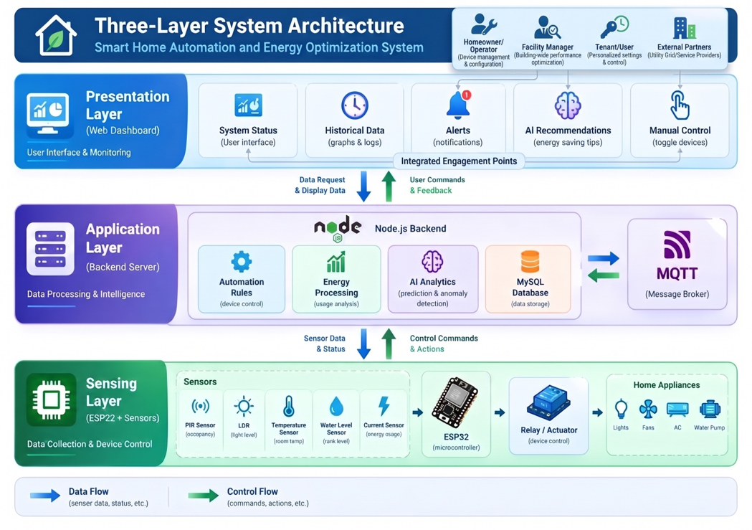
Notes:
Al Ruman: Presentation layer (web dashboard), application layer (Node.js, rules, energy processing, AI, MySQL, MQTT broker) and sensing layer (ESP32, sensors, relays). Blue arrows show data flow, green arrows show control flow.

Slide 11
Timeline: 12 Weeks
W1
W2
W3
W4
W5
W6
W7
W8
W9
W10
W11
W12
Problem & Background
Requirement Analysis
System Design
Hardware & Core Dev
AI Model Development
Dashboard & Integration
Testing
Documentation & Submission
Notes:
Rafid: Explain the 12-week plan, from background research in weeks 1-2 to final submission in week 12.

Slide 12

Work Distribution
AR
Md. Al Ruman
RI
S. M. Rafid Islam
PRIMARY
PRIMARY
Backend development (Node.js, database)
AI model development (prediction and anomaly detection)
Hardware & sensor integration (ESP32, PIR, LDR, water level sensor, relay wiring)
MQTT communication setup
Secondary: Web dashboard & documentation
Secondary: Testing & prototype demonstration
Shared by both: requirement analysis and system design (Use Case, DFD, ER diagram), integration testing, report writing and final presentation.
Notes:
Al Ruman: Backend and AI. Rafid: hardware and MQTT. Shared: design, integration testing, report and presentation.

Slide 13
Budget Estimation
Item | Purpose | Cost (BDT)
ESP32 Microcontroller (x2) | Main controller | 1,200
PIR Sensors (x3-4) | Occupancy detection | 600
LDR Sensors (x3-4) | Daylight sensing | 300
Water Level Sensor | Tank monitoring | 700
Current / CT Sensor | Usage measurement | 800
Relay Modules | Appliance switching | 500
Temperature Sensor | Fan / AC control | 300
Wiring, breadboard, misc. | Prototype assembly | 1,000
Cloud hosting (basic tier) | Backend and database | 1,500
Miscellaneous / contingency | Unexpected costs | 1,000
TOTAL ESTIMATE
≈ 7,900
BDT
All software tools (Node.js, MySQL, Python, VS Code, GitHub) are open-source, so cost is mainly hardware prototyping and a small amount of hosting.
Notes:
Rafid: The total is about 7,900 BDT. Software is open-source; cost is mostly hardware and basic hosting.

Slide 14
Risks & Mitigation
Risk | Mitigation
Inaccurate sensor readings | Calibrate sensors; use filtering and hysteresis to avoid false actions
Limited AI accuracy (little real data) | Combine simulated and prototype data; treat AI output as recommendations
ESP32 to backend connectivity issues | Use MQTT with local buffering during disconnects
Hardware damage during testing | Test on low-voltage, safe setups; no direct mains installation
Time constraints in the semester | Follow the 12-week plan and build core features first
Over-reliance on automation | Manual override is always available
Notes:
Rafid: Highlight the main risks and how we reduce them.

Slide 15

Expected Outcome & Future Work
Working prototype
Future Work
Automatic control of lights, fans/AC and the water pump using real sensor data.
AI-based security and life safety
Gas leakage monitoring
Rural and farm monitoring
Mobile app and smart platform integration
Larger-scale deployment and better AI models
AI component
Predicts electricity consumption and detects unusual usage.
Web dashboard
Live and historical usage, alerts, suggestions and manual control.
Test results & documentation
Energy-use comparison, design diagrams, source code and final report.
Notes:
Al Ruman: Summarise the expected deliverables, then mention future extensions briefly.

Slide 16

Conclusion
Easier daily life
Less waste, full control
Built for Bangladesh
Combines home automation, energy monitoring and AI analysis to reduce manual work.
Helps cut unnecessary electricity use while manual override stays available.
Considers prepaid meters and load-shedding in energy information.
A strong foundation for a practical, student-level smart home prototype.
Notes:
Al Ruman: Close with the three key points and the final statement.

Slide 17
References
[1] Abdullah-Al-Mahbub, M., et al. (2022). Different Forms of Solar Energy Progress: The Fast-Growing Eco-Friendly Energy Source in Bangladesh for a Sustainable Future. Energies, 15(18), 6790.
[2] Nasir, M., et al. (2019). Grid Load Reduction through Optimized PV Power Utilization in Intermittent Grids Using a Low-Cost Hardware Platform. Energies, 12(9), 1764.
[3] Mahjoub, S., et al. (2023). Short-Term Occupancy Forecasting for a Smart Home Using Optimized Weight Updates Based on GA and PSO Algorithms for an LSTM Network. Energies, 16(4), 1641.
[4] Demir, F., & Sonmez, O. (2025). A Real-Time Water Level and Discharge Monitoring Station: A Case Study of the Sakarya River. Applied Sciences, 15(4), 1910.
[5] Kok, C. L., et al. (2024). A Novel Water Level Control System for Sustainable Aquarium Use. Electronics, 13(11), 2033.
[6] Sabit, H. (2025). Artificial Intelligence-Based Smart Security System Using Internet of Things for Smart Home Applications. Electronics, 14(3), 608.
Notes:
Reference list from the proposal.

Slide 18
Thank You
Any questions?
Md. Al Ruman · S. M. Rafid Islam
Notes:
Both: Thank the teacher and invite questions.

